Slide 1
Portofolio
Mian Wang
Seeking for an Internship at WRECO

Slide 2
CONTENTS
01
Part One
About me
02
Part Two
Why WRECO?
03
Part Three
Why are we a perfect match?
04
Part Four
Questions

Slide 3
CONTENTS
01
Part One
About me

Slide 4



1. About me

Slide 5
1. About me
Water Quality
Environmental Processes
Water Resources
Environmental Remediation
R
MS Excel
AutoCAD
ArcGIS
90%
90%
60%
50%
80%
90%
60%
50%

Slide 6

1. About me
Data Analysis
Water Quality
Piano
Environmental Engineering
Passionate about work and life
Diligent
Quick Learner
Running
Quick Learner
Sustainability

Slide 7

Education
Publications
Environmental Processes
Coursework
Data Analysis
Engineering Drafting
Thesis
Project

Slide 8
Internship
Research
Study disinfection byproduct formation upon ozonation
Research on different phosphate analyzer
Office Work
Data normalization
Water quality report
O&M meetings
Field Work
Operate a reverse-osmosis pilot
Pipeline disinfection

Slide 9
CONTENTS
02
Part Two
Why WRECO?

Slide 10
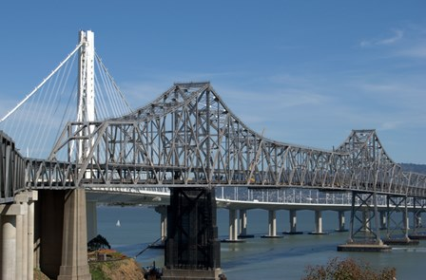
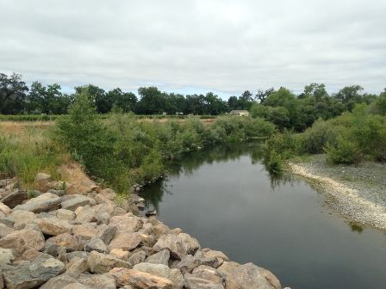

2. Why WRECO?
Civil Engineering & Infrastructure
Environmental Engineering
Geotechnical Engineering
Civil design & site development
Construction inspection
Green infrastructure
Water resources
Hydrology & hydraulic engineering
Water quality
Environmental compliances
Photo credit: http://www.wreco.com/news.html

Slide 11
Why is WRECO unique for me?
Projects
Consulting
Water quality
Water resources
Environmental Compliance
Negotiation
Communication
Engineering
Value
Design
Modeling
Analysis
Experiment
Sustainability
Diversity

Slide 12
CONTENTS
03
Part Three
Why are we a perfect match?

Slide 13
Matching
Motivation
Value
Strengths
To become an extinguished engineer
Provide feasible and cost-effective solutions
Sustainability
Diversity
Data analysis
Engineering design

Slide 14
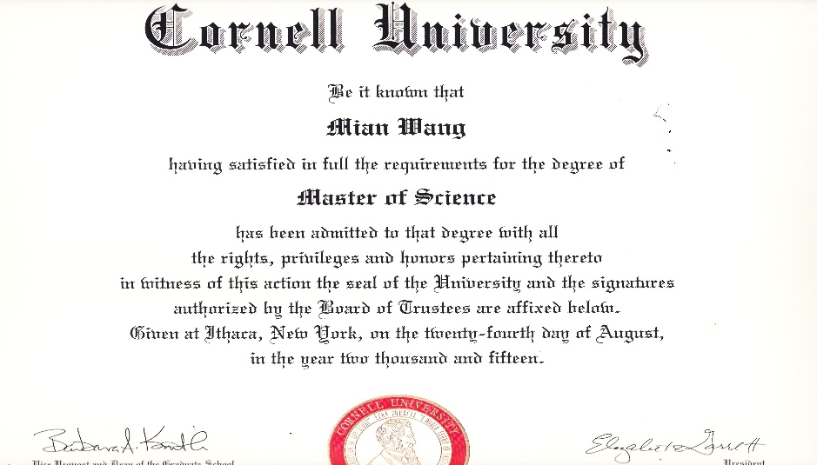
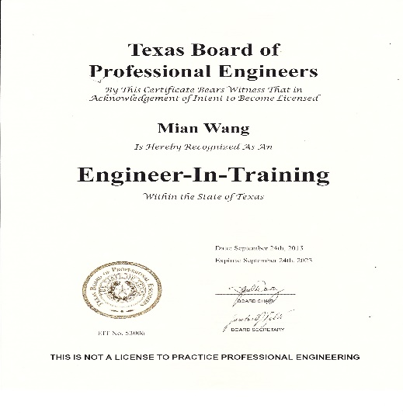
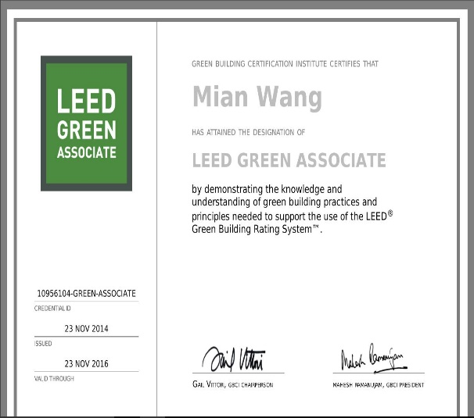
My Certifications
EIT
M.S. in Environmental Engineering
LEED Green Associate

Slide 15
CONTENTS
04
Part Four
Questions

Slide 16
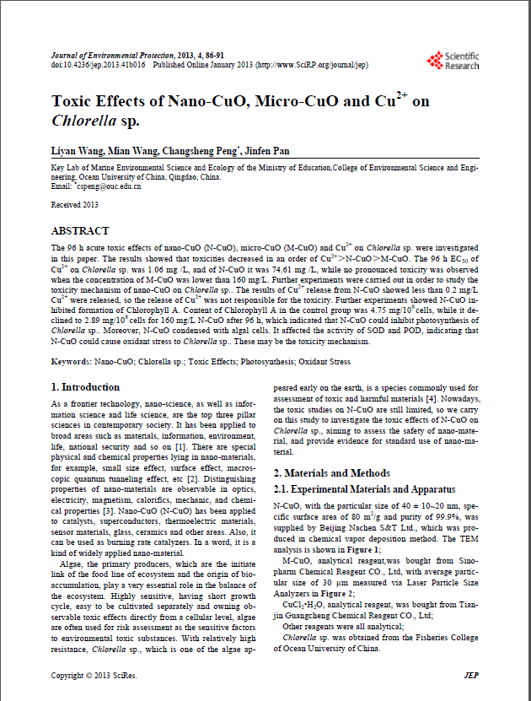
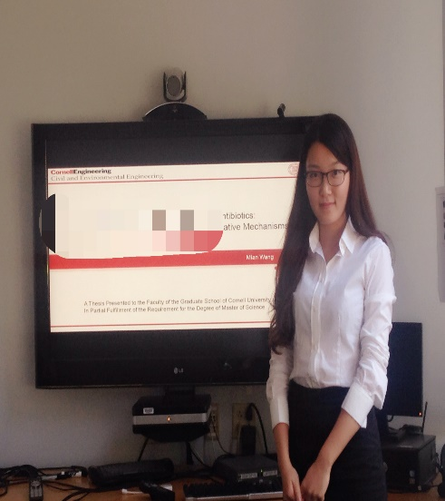
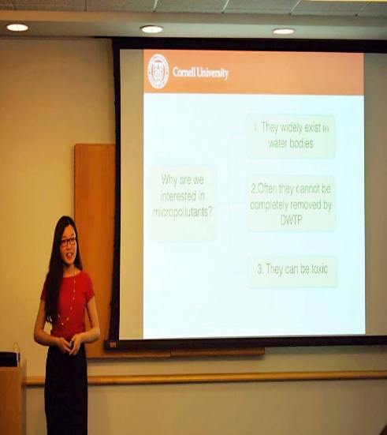
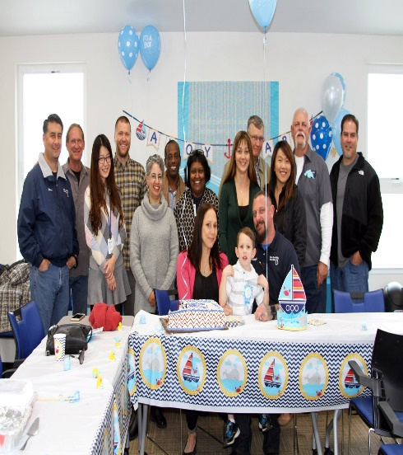
Thank you
Publication
Thesis Defense
Symposium
Happy time with coworkers

